Slide 1

EDUCATIONAL APPS
UBA3021
PLACEMENT TRAINING FOR PROSPECTIVE ENGINEERS
PRESENTED BY
SREE. B [192524023]
SRIHARI. S [192524389]
KAVIYA. G [192524281]
MALLIREDDY PUSHPA CHANADAN [192513026]
NIRANJAN MUTHUSAMY [192514046]
MOHAMED RAFI [192514046]
GUIDE
Dr. PARKAVI

Slide 2



INTRODUCTION
Transform learning with educational apps—digital tools designed for phones, tablets, and computers to make studying easier, faster, and more enjoyable
Empower students to learn anytime, anywhere, and in any subject through interactive videos, engaging quizzes, and entertaining games
Deliver personalized lessons, support teachers in managing classes, and assist in tracking students’ progress effectively
Revolutionize education by making learning engaging, enhancing digital skills, and integrating modern technology

Slide 3
OBJECTIVES
To know the good and bad sides of using educational apps.
To know what an educational app is and how it helps in learning.
To understand how students can study anytime and anywhere using apps.
To learn the main benefits of using educational apps every day.
To find out which learning apps are popular among students.

Slide 4

IEEE
The IEEE App is a
Digital learning platform,
Developed by the Institute of Electrical and Electronics Engineers,
To support students, educators, and professionals in the field of science, engineering, and technology
Headquarters located in Manhattan, New York

Slide 5
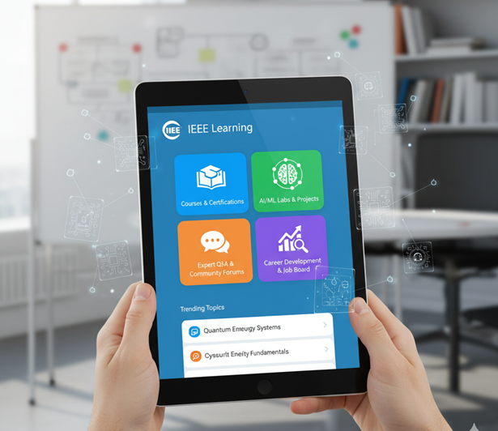
KEY FEATURES
Access to educational materials.
Find and join meetups or IEEE events (virtual or physical) filtered.
Access to IEEE’s resources.
Locate other IEEE members by interests, location, or affiliations.

Slide 6
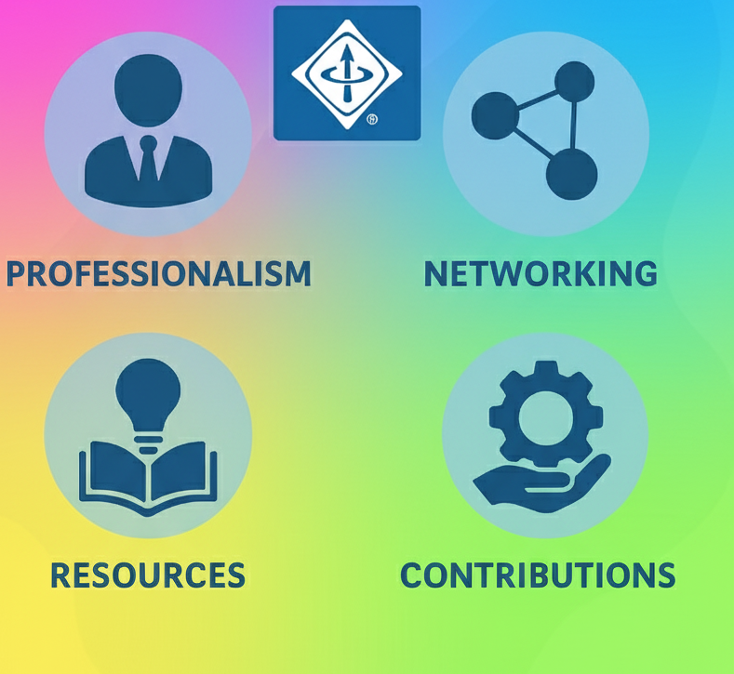
ADVANTAGES
Professional & Career Advancement.
Promotes Global Networking .
Supports Research and Innovation.
Builds Technical Skills.

Slide 7
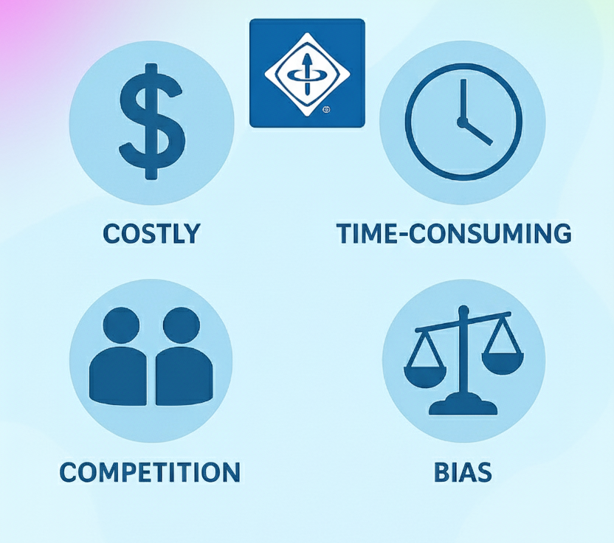
DISADVANTAGES
Access only to paid membership.
Limited offline Access.
Lack of Personalized support.
Lack of proper guidance.

Slide 8
FUTURE DEVELOPMENT
Focus on development of AI with IoT.
Development of Soft skills like project management, team- work, communication skills.
Developing interdisciplinary skills with various fields.
Practical Real-World Applications.

Slide 9

DUOLINGO
Oneof the popular free version language learning app that uses gamified and bit-sized approach to teach,
Languages
Mathematics
Music
Chess

Slide 10

KEY FEATURES
The key features are
Gamified learning
Bit sized Lessons
Comprehensive learning
Personalized learning
Motivational tools

Slide 11
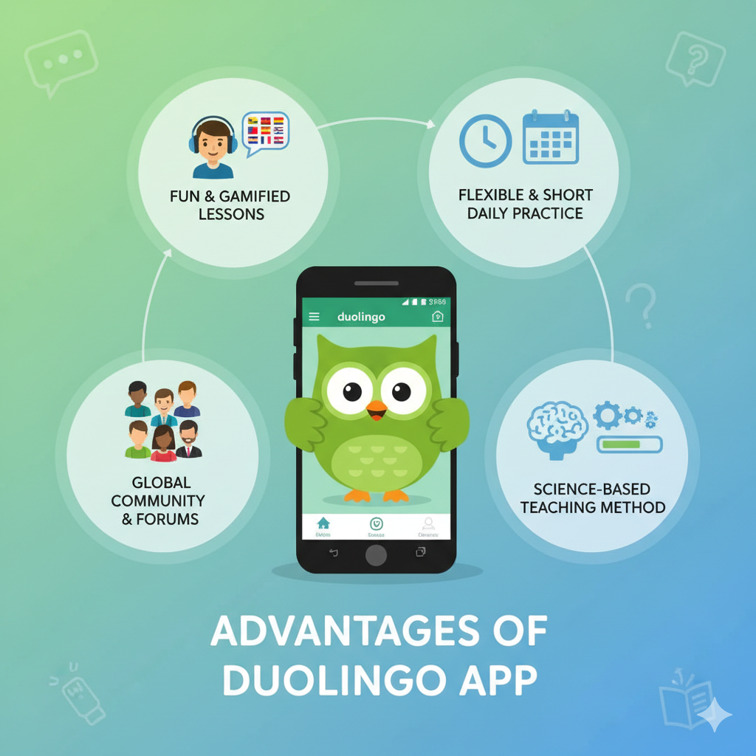
ADVANTAGES
Offers Free and Flexible learning.
Interactive and Effective in learning.
Contextual Learning.
Supports 40 diverse languages.

Slide 12
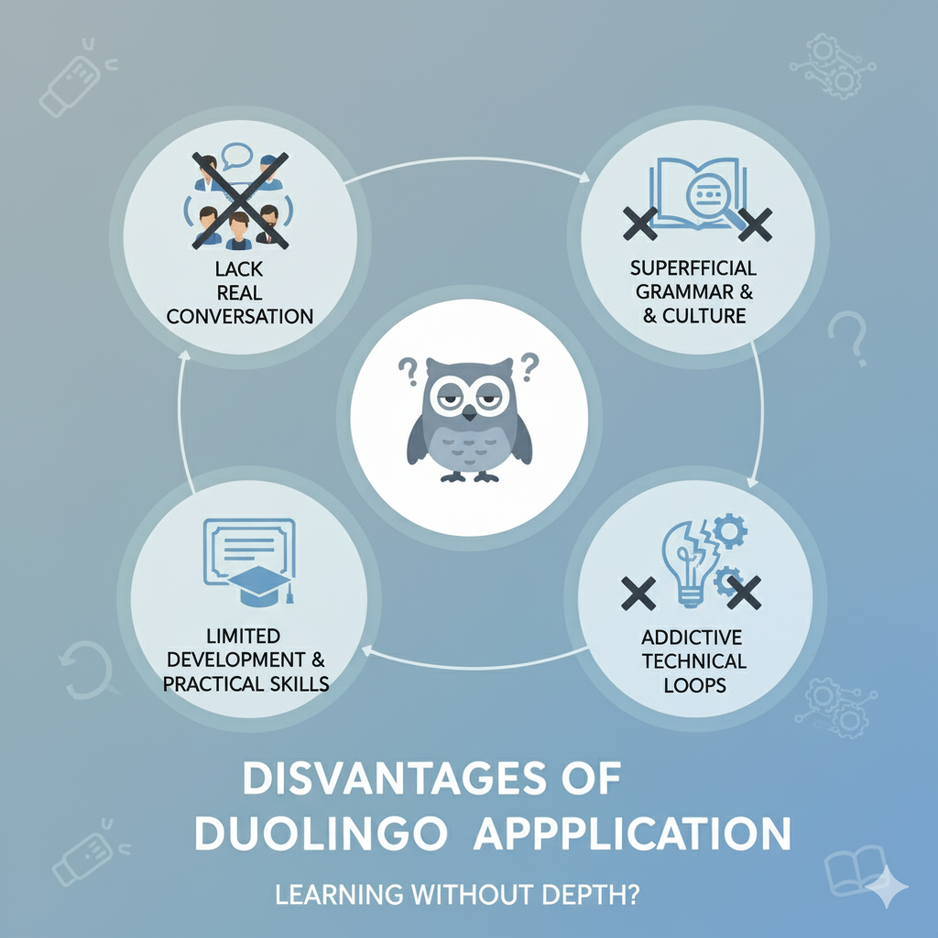
DISADVANTAGES
Insufficient Grammar Explanation.
Minimal Speaking and Listening Practice.
Misleading Expectations.
Contents are repetitive.

Slide 13

BYJU’S
Transforms learning through engaging video lessons, simplifies concepts with interactive animations.
Empowers students to study anytime, anywhere, encourages curiosity across subjects.

Slide 14
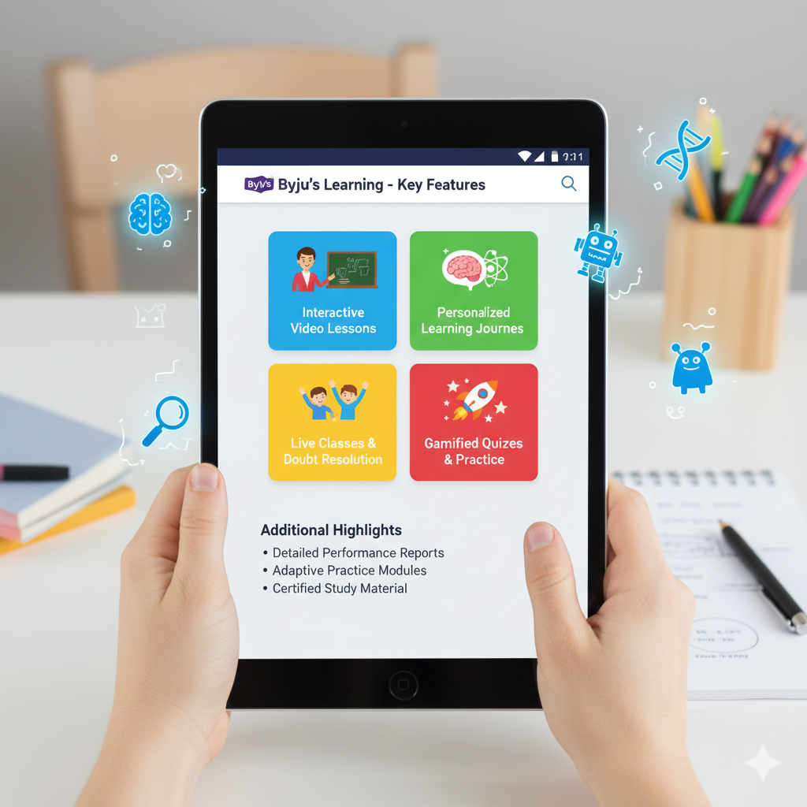
KEY FEATURES
Personalized Learning.
Practice Tests and Quizzes.
24/7 Learning Access.

Slide 15
ADVANTAGES
Interactive learning makes understand concepts easily.
Adaptive lessons fit each student’s pace, style.
Accessible contents to learn anytime, anywhere.
Empowering practice builds confidence, curiosity, and strong understanding.

Slide 16
DISADVANTAGES
Requires gadgets and strong internet.
Reduces face-to-face interaction and guidance.
Encourages screen dependence and less physical activity.
Involves high subscription costs.
Involves distractions from other mobile apps.

Slide 17


LINKEDIN
LEARNING​
It offers thousands of expert video courses in many subjects
Helps students and professionals develop new skills for their career
Available anytime and anywhere through mobile and desktop
Courses are taught by industry experts and professionals

Slide 18
KEY FEATURES
Offers over 16,000+ video courses in many fields (technology, business, design, etc.)
Courses are available in multiple languages
Learners can get certificates after completing courses
Personalized recommendations based on your career interests
Download videos for offline learning

Slide 19
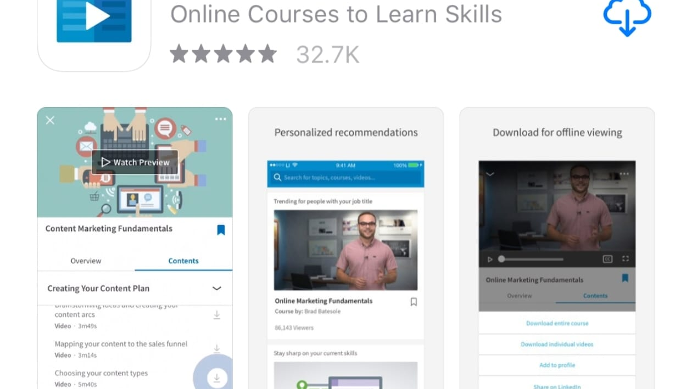
HOW IT WORKS
Earn completion certificates
Users sign in using a LinkedIn account
Search or browse desired courses
Watch video lessons at your own pace
Take quizzes after modules for practice
Certificates can be shared on LinkedIn profile

Slide 20
ADVANTAGES AND DISADVANTAGES
ADVANTAGES | DISADVANTAGES
Learn anytime, anywhere | Requires good internet connection
Offers expert-taught courses | Some advanced courses are paid
Gives certificates for completed courses | Limited free content
Improves career and professional skills | Less interactive compared to live classes
User-friendly and supports many devices | Certificates may not replace formal degrees

Slide 21
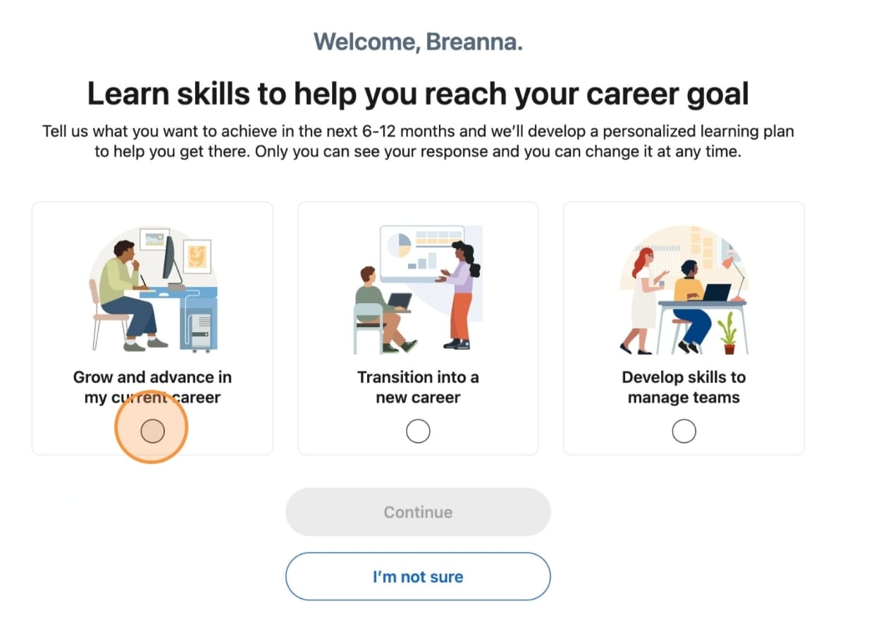
TARGETS
Students looking to gain extra skills
Working professionals aiming for promotion
Job seekers enhancing employability
Educators improving teaching skills
Anyone interested in self-improvement and growth

Slide 22


CONCLUTION
LinkedIn Learning is a powerful educational app
It bridges the gap between education and employment
Offers affordable and flexible learning
Helps users stay updated with new industry trends
Trusted by millions of learners worldwide

Slide 23

GOOGLE CLASSROOM
INTRODUCTION
Free online learning platform developed by Google for Education.
Designed to help teachers and students manage coursework digitally.
Available via web browser and mobile app (Android & iOS).

Slide 24
KEY FEATURES
Integration with Google Docs, Drive, Meet, and Forms.
Real-time feedback and grading system.
Stream for announcements and discussions.
Auto-saving materials in Google Drive.
Benefits: Saves time and paper. Encourages organized and interactive learning. Boosts collaboration and engagement.

Slide 25

ADVANTAGES
Used in schools, colleges, and corporate training.
Ideal for assignments, announcements, and assessments.

Slide 26
DISADVANTAGES
Needs reliable internet access. Less suitable for lab-based/practical courses.
Possible digital distractions for students.

Slide 27
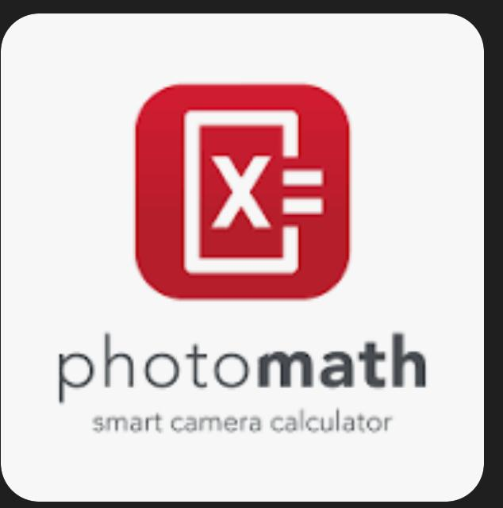
PHOTOMATH
Photomath is a mobile app that helps users solve math problems
It provides step-by-step solutions and detailed explanations.

Slide 28

KEY FEATURES
Camera Scan: Instantly reads handwritten or printed math problems
Step-by-Step Solutions: Explains each step for better understanding
Handwriting Recognition: Detects handwritten equations accurately
Covers Topics: Arithmetic, Algebra, Geometry, Trigonometry, Calculus

Slide 29
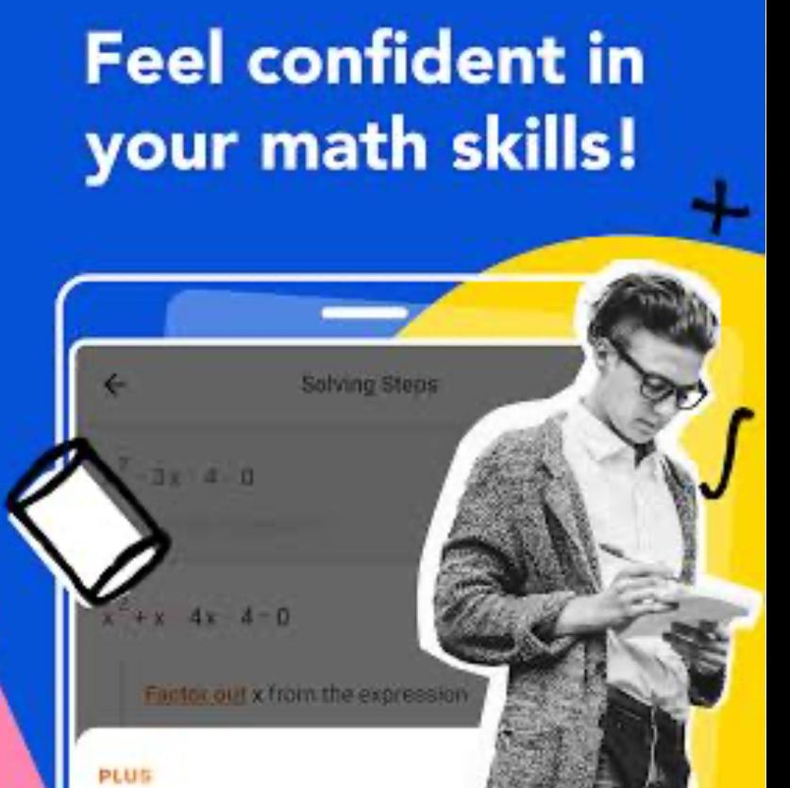
ADVANTAGES
Improves problem-solving skills and concept clarity
Encourages self-learning and practice
Builds confidence in mathematics

Slide 30

DISADVANTAGES
Overuse can make students depend too much on it
May not scan unclear or complex handwriting
Some features require internet or paid access
Cannot fully replace teacher explanations

Slide 31
CONCLUSION
Ultimately, educational apps are powerful tools, when used strategically, can revolutionize the learning process.
However, their implementation requires careful consideration of potential drawbacks, such as data privacy.
By embracing emerging technologies like AI and VR, educational apps will continue to evolve, shaping a more dynamic, inclusive, and effective learning environment for future generations.

Slide 32


